Slide 1
Test Selection Practices in a Large IT Company
Vincent Blondeau
Notes:
I wanted to thank the jury to have read my manuscript and to be here at my defense.

Slide 2
Agenda
Presentation of the industrial context
Identifying root causes of project failures
Improving testing habits of Worldline developers
Conclusion and future work
Notes:
The agenda of the presentation is the following:
First, I will present the industrial environment of my PhD.
Then, I will focus on how we identified root causes of project failures.
I will continue by presenting how we improved the testing habits of Worldline developers.
I finish by concluding and presenting the future works

Slide 3
Industrial Context
Notes:
First, I will present the industrial context

Slide 4
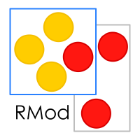
Industrial Context: Worldline
Notes:
Industrial PhD in a major international IT company.
Worldline: european leader in the payements and transactional services industry
7 300 employees
17 countries
Worldline belongs to Atos.
Supervised by RMod team (Inria)

Slide 5
Industrial Context: Worldline
Global Business Units
Merchant Services
Financial Services
Mobility & eTransactional Services
Benelux
Germany & CEE
France
Regional Business Units
UK
APAC
LATAM & Iberia
Transversal Operational Units
Production Services
Software Development Community Office
Notes:
Bu -> development
We tried to took people of the 3 business lines to perform our experiments
-> France
Transversal -> support to the business units
Moi = SDCO

Slide 6
How to Predict the Health of a Project?
Notes:
Worldline wants to use project data to avoid the failure of its projects.
So, the question is …
It is an explanatory study

Slide 7
Project Health: Definition
Scope
Resources
Schedule
Notes:
For a project we define:
Scope (features)
Resources (man-days)
Schedule (milestones)
A project is in good health the 3 criteria are met
Else it is in bad health
Transition: Now the health of the project is defined, we can first search to resolve our initial problem thanks to the literature

Slide 8
Systematic Literature Review
Structure defined by [Staff Keeke et al., 2007]
Population: Software projects
Intervention: Predict health (success or failure)
Comparison: Cross projects
Outcome: Model based on metrics
Context: Industrial
What metrics could help predict the success or failure of a project?
Notes:
We made a systematic literature review.
We defined the structure we used to reproduce so that others can reproduce our review.
Staff KICK describes 5 topics:
Population is the subjects of the experiments. Here: …
Intervention is the operation we want to do with them.
Comparison is what we want to compare the prediction of software projects.
Outcome is what we want to obtain.
Context is the envrionement.
RQ: …

Slide 9
Systematic Literature Review
Keywords: Predict & Software & Project & Metric & (success | failure)
Data source | Match | Selected
 |  | On Title | On Abstract | On Full Text
IEEExplore | 7 | 3 | 2 | 0
ACM | 189 | 52 | 11 | 4
Science Direct | 128 | 9 | 4 | 3
Springer | 1370 | 42 | 15 | 7 | Total
Wiley | 2 | 2 | 2 | 0 | 14
Notes:
The structure helps us define some keywords, that were looked up in 5 databases : ItripleE …
And read almost 1 700 titles
In total, 14 interesting papers were found.
Transition: they all concludes that:

Slide 10
Systematic Literature Review
Individually, metrics to make predictions exist
No unique metric for all the projects
Predictions retrospectively
Notes:
…
The literature is inconclusive
but our context is different.
Can we try something in ours?

Slide 11
Data Mining
Correlation of project metrics
Budget: 2
Bugs: 8
Slippage: 3
Project Name (placebo metric)
From managers Excel files
19 projects
Average 1400 man-days
Between 900 to 2300 man-days
91 excel files
2012 to 2015
Notes:
More especially, we made correlation with project metrics
Slippage is the number of resources in excess to the initial contract made with the client.
All the data were extracted from one BU from excel files
Transition: Here are the results

Slide 12
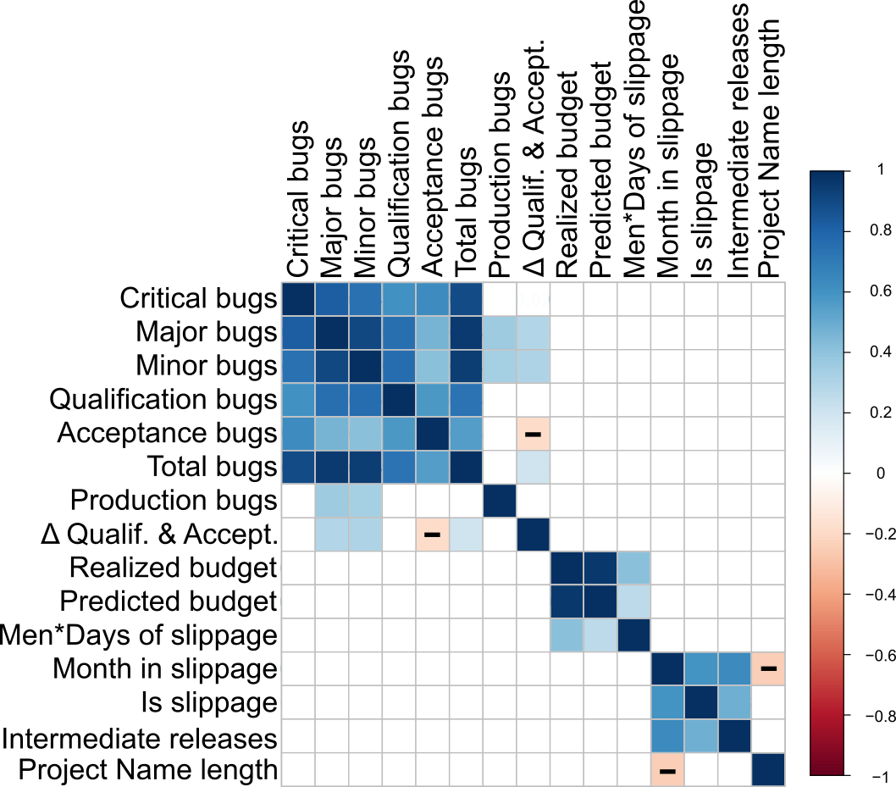
Data Mining
Correlation method:
Spearman
Bugs
Budget
Slippage
12
Notes:
Correlated metrics,
Square,
Scale
0.3 -> light blue or red -> no correlation (see legend)
Bugs are correlated together except the production bugs (revealed by the end user) and the delta between the qualification and acceptance bugs.
Budget metrics are correlated together
Slippage too
Placebo metric
TRANSITION : others are not

Slide 13
Data Mining
We were not able to predict project health
Notes:
…
literature do not give hints to predict health in general
data mining taht we made did not work in our case.
So, a logical following is to ask people what are the root cause of failure for them.
Project leaders: inside project team and concrete view on the project
Quality managers: transversal view of the projects
Both have a global view on the projets and have more experience than the developers
Only 7 participants -> difficult to have interviews -> lack of time + tight schedules on projects

Slide 14
Pilot Study
Delay at the start of the project
Lack of team cohesion
Lack of collaboration between team and client
Misunderstanding of requirements
Misunderstanding of application domain concepts
Lack of experience with the used frameworks
Change of the framework during the project
Bypass qualification tests
[Blondeau et al., IWST’15] [Blondeau et al., SATToSE’15]
Notes:
The meetings allowed to identify criteria related to various topics:
the date where the project starts
the relation inside the team and with the client
a bad undestanding of the client needs or of the application domain
technical issues related to the frameworks: lack of experience or change during the project
bypassing of the tests
-> It is common sense
-> Most of these root causes are not easilly measurable or quantifiable.
And provide a tool to act on them is not possible. -> difficult to set up in a predictive model.
Transition: However, we wanted to confirm this results by extending to more Worldline employees

Slide 15
Questionnaire
Notes:
Based on the pilot study
We made a questionnaire focused on project health
9 questions
131 respondants
Confirm the previous conclusions
Transition: In these conclusions, we saw that testing was one of the points that have a role to play.

Slide 16
Questionnaire
“In order to improve project health, what tool could help you?”
…
Notes:
…
The respondants have to give an answer on a likert scale on 4.
Red negative utility and blue positive utility
20 items have to be answered in this question.
They are sorted by order of preference. The more essential in first.
In the 4 first items, 3 items are on the tests: …. -> cite et montrer -> 2, 3, 4

Slide 17
Summary
As far as we know:
Literature did not apply
Data mining did not work
Interviews identified root causes of failure
Not easy to measure it
Questionnaire confirmed the results
Give up the project health prediction problem
Notes:
To summarize,
The literature did not work in our case to predict failure
like the data mining we appliyed
We identified root causes in the interviews, but we cannot measure them easily
And the questionnaire confirms the results on root causes and allowed to identify some points were we can act
So we give up ….
Transition: New thesis on a related topic:

Slide 18
Thesis
Can we improve the testing habits of Worldline developers?
(by giving them faster feedback)
Notes:
We identified that the developers bypassed the tests -> lack of time
We hope that by reducing the time, they change their practices, test more and
less bugs are detected in production.
Increase project health

Slide 19
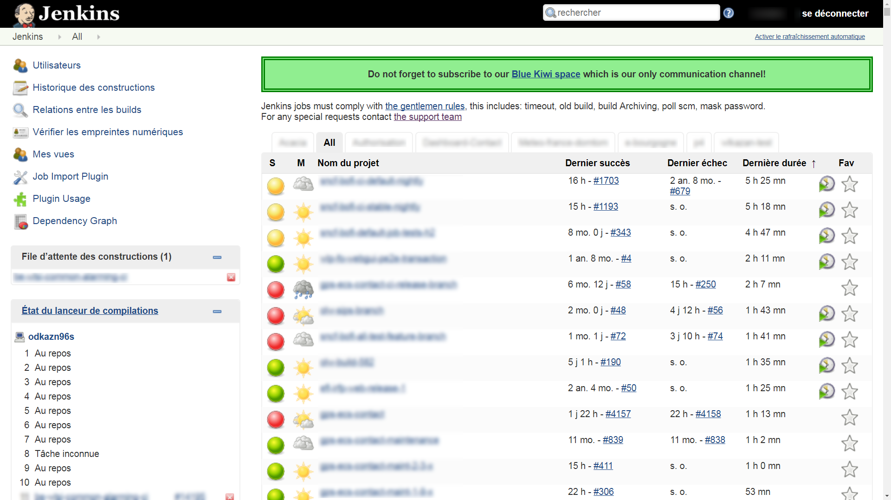
New Problem
Notes:
That is how the tests are detected: with Jenkins.
For a developer, the tests are only run during the night.
He has to wait the next morning to get the results of the tests.
And it can happens that they fails…
There is no immediate feedback
So it decreases the quality of the applications that are produced by the company
Transition: But, there is hope: test selection

Slide 20
Test Selection
Example
Notes:
If we change M1, we relaunch only test1 because it is the only one that covers it
Transition: this way, we reduce the number of tests to relaunch after a change.
For one project

Slide 21
Test Selection
Automatic Test Selection
Select only the tests related to the changes and run only those ones
3 hours
5 minutes
Notes:
we succeed to reduce testing time from initially 3 hours to 5 minutes for a given project.
This is based on actual measurements, that I will explain later.

Slide 22
Strategy
Can we improve the testing habits of Worldline developers? (by giving them faster feedback)
Choose a test selection approach
Establish current testing behavior of developers
Create a test selection tool
Notes:
To answer to the thesis problem, our strategy is to first:
Choose a test selection approach adapted to Worldline
Second: Establish current testing behaviour of Worldline developers to know them better
Third: create a test selection tool that implement the choosen solution

Slide 23
Agenda
Presentation of the industrial context
Identifying root causes of project failures
Improving Testing Habits of Worldline developers
Choose a test selection approach
Establish current testing behavior of developers
Create a test selection tool
Conclusion and Future work

Slide 24
Choose a Test Selection Approach

Slide 25
Literature Review
Kazmi et al. “Effective regression test case selection: A systematic literature review”, ACM Comput. Surv., 2017
Mining and Learning
Model Based Testing
Program Slicing
Oracle
Control Flow Graph
Notes:
Several approaches to select tests, but the one adapted for Worldline is the
Control flow graph: workflow of program behavior or functions

Slide 26
Two Approaches
T
T
T
T
T
T
T
Dynamic
Static
Notes:
Dynamic Approach
Execute the tests
Map the tests to the covered code
Relaunch the tests related to source code changed
Static Approach
Create a model of the system
From the code with a static analysis tool
Navigate the call graph from changed source code back to the tests

Slide 27
Feasability Study
Which approach can we use at Worldline?
Dynamic more accurate
But should be kept up to date
Dynamic problem of failing tests
Static faster in our case
Feasability study on 3 sample projects
Notes:
The dynamic mapping should be updated at each change by relaunching the tests.
Else the approach loose precision.
Failing tests issue: if the test is failing, the methods that should be invoked after the failure are not launched.
This issue is not negligible in Worldline.
Because tests take time

Slide 28
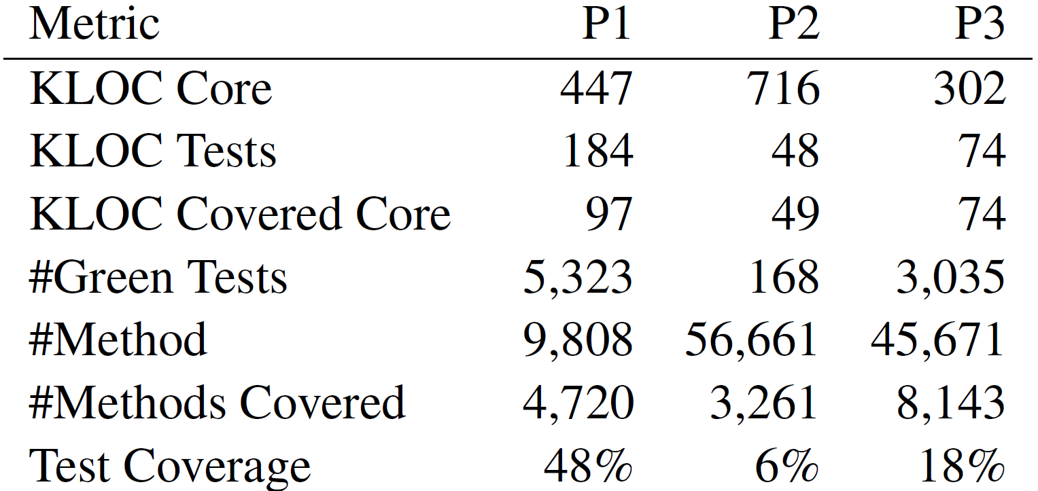
Feasability Study
Notes:
The project are importants with more that three hundreds thousands lines of code.
Real projects of the company
Written in Java
Tests are present
P1 has an acceptable coverage of almost 50%
And the others are quite low

Slide 29
Breaks
Issues to retrieve the tests from the changed code
Identified and classified as:
Dynamic breaks
Third Party breaks
Multi-program breaks
Polymorphism breaks
[Blondeau et al., Software Quality Journal, 2016]
[Blondeau et al., IWST’16], [Blondeau et al., BENEVOL’15]
Notes:
When we started the test selection with this feasability issue, some problems appared:
We identified and classified ourselves the issues.
But, will describe only the ones that an impact on the Worldline projects

Slide 30
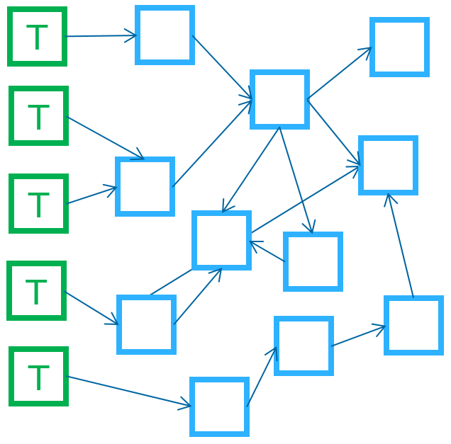
Dynamic breaks: Attribute Initialization
Notes:
Only for static.
Class instance initialisation
Break in the flow between the test and the change
Attribute never called by a method but by the constructor of the class

Slide 31
Third Party breaks: Anonymous Classes
Notes:
The anonymous method is never called directly but through a callback.
To resolve this, going up the container link

Slide 32
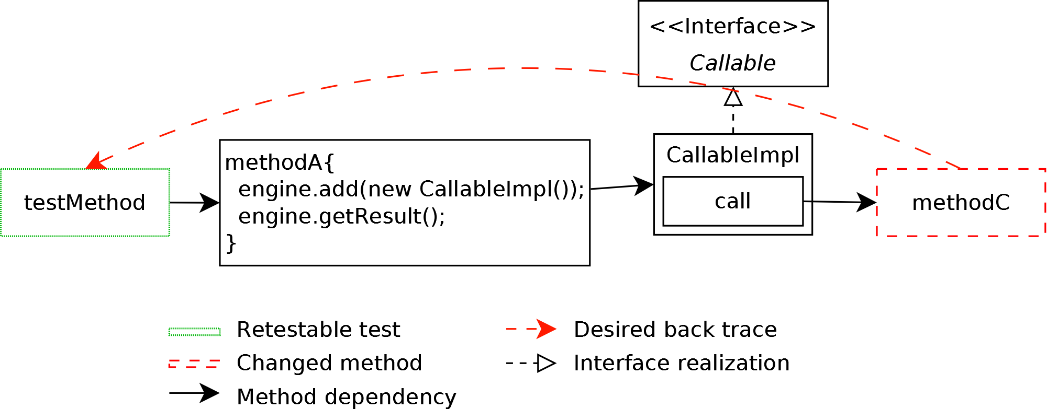
Third Party breaks: Delayed Execution
Notes:
Here it is a indirect call of the call method.
Call method is never called directly
Commonly referenced as callback
Special mapping
Can be resolved by looking to the contructors of the CallableImpl class

Slide 33
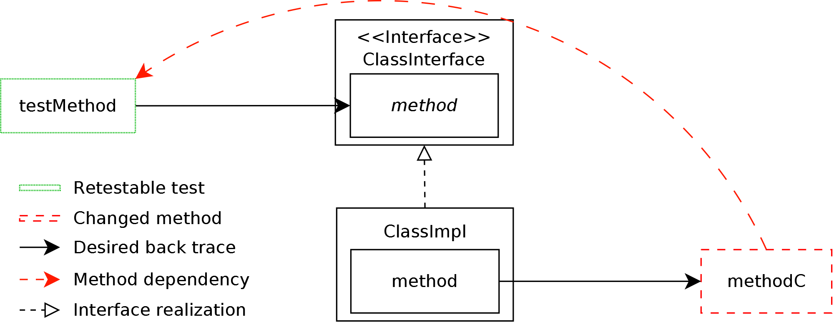
Polymorphism breaks: Interfaces
Notes:
Only for static.
Inheritance and overloading of methods

Slide 34
Research Questions
What is the impact on test selection of:
Granularity (class, method)?
Third-party breaks issue resolution?
Dynamic breaks issue resolution?
Polymorphism breaks issue resolution?
Combined solutions?
Notes:
To study feasibility to see if static can be used for test selection on WL projects,
We asked some RQ:

Slide 35
Case Study
Ratio of the total test suite selected
Precision
How many selected tests are relevant?
Recall
How many relevant tests are selected?
Notes:
To measure the impact, we used these three metrics:

Slide 36
Case Study
Compared several static approaches resolving the issues
Dynamic approach is the oracle
Considered each covered method as changed
T
M
T
T
M
M
M
T
M
Notes:
More precisely, …
We choose dynamic approach as the oracle
Some tests are without methods if they fail or are skipped

Slide 37
Tooling
Notes:
We used several tools to make this case study.
First, Jacoco is a code coverage tool, -> modified in order to get the coverage for each test.
Second, Infinitest is IDE plugin that performs test selection,
Take times for large projects
based on Java bytecode analysis.
resolves the third party breaks issues (libraries).
Third, Moose is a tool to model, visualize, and analyse software.
We used it here to implement our static approaches that resolve each breaks

Slide 38
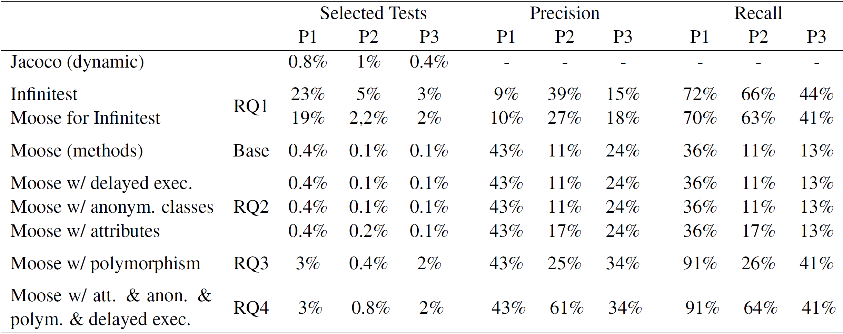
Results
Notes:
Tested configuration on the left.
For each, we gave the metrics: number of selected tests, precision and recall for Each project
Jacoco is the oracle: dynamic approach

Slide 39
Results: Finer granularity?
Number of Selected Tests
Precision
Recall
Notes:
Number of selected tests is decreasing with a finer granularity, precision increase and recall decrease
(Pas le temps de rentrer dans les details)

Slide 40
Results: Third-party break issue?
Number of Selected Tests
Precision
Recall
Notes:
Third party break is when a library is in the middle of the class call
The baseline is Moose at class level

Slide 41
Results: Polymorphism break issue?
Number of Selected Tests
Precision
Recall

Slide 42
Results: Dynamic break issue?
Number of Selected Tests
Precision
Recall

Slide 43
Results: Combined solutions?
Number of Selected Tests
Precision
Recall

Slide 44
Results
Breaks
are intertwined
impact differently each project
have different solutions for a given break class
Good final result: 3% of tests selected
Notes:
For the best project
precision: 41%
Recall: 91%
Transition: if we apply it on a project:

Slide 45
Results
Notes:
…
That is are better than test selection made by the developers.
It is possible to create a test selection tool with the static approach.
Transition: but first, we want to understand the behavior of Worldline developers to adapt the tool to them

Slide 46
Current Testing Behavior
Notes:
Transition: Literature already studied this problem:

Slide 47
When, How, and Why Developers Test Beller et al. (2015)
Open-source + industry + students
Monitor 416 software engineers
Main conclusions
Majority of the developers rarely test in their IDE
Quick tests do not lead to more test executions
Some failing tests are fixed later: 50% of the test repairs happen within 10 minutes whereas 75% within 25 minutes
Notes:
First there is the experiment of Beller and ZAIDMAN et al.
- mix of open source and industry and students without distinction
- Monitor more than four hundreds developers
Draw conclusions:

Slide 48
Comparison of Manual and Automated Test Selection – Gligoric et al. (2014)
How developers manually select tests
Compare it to an automatic selection
Academic experiment: 14 developers: 5 professionals + 9 students
Main conclusions
Need for better automated test selection techniques
Better integration with developer IDEs
Notes:
Another study is the one of Gligoric.
The authors studied how developers manually select tests and compare them to an automatic selection

Slide 49
Field Study
Literature conclusions are not trivially transposable to our industrial case
Open source projects
Students
Need another study
Based on the replication of the 2 literature studies
In our context

Slide 50
Field Study
Research Questions:
Do developers test their code changes?
Do quick tests lead to more test executions?
Do developers practice test selection?
Does manual test selection depend on size of code changes?
How manual test selection compares to automatic test selection?

Slide 51
Field Study
Install a plugin recording anonymously test executions in IDE
32 participants
Interviews with the developers
11 participants on 32
20-30 minutes
Present themselves
Describe their testing behavior in their context
Notes:
interviews: to explain the quantitative results

Slide 52
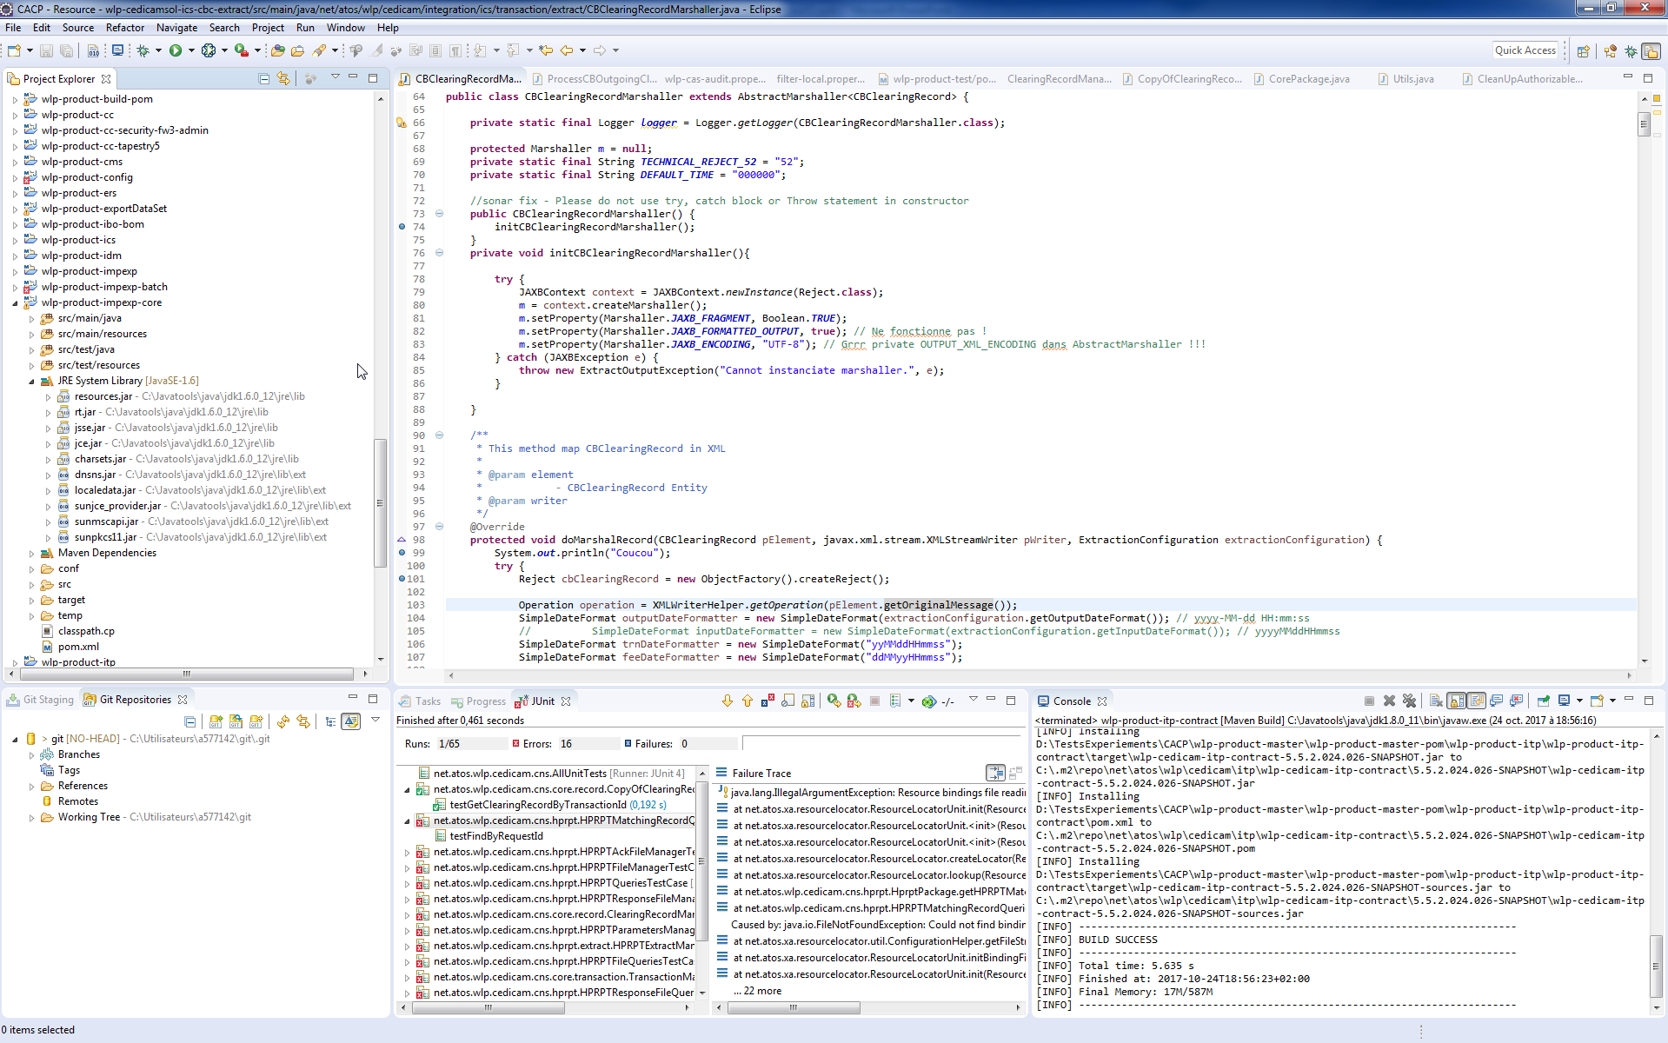
Notes:
That is Eclipse the IDE of the developer.
3 tools
before the plugin installation

Slide 53
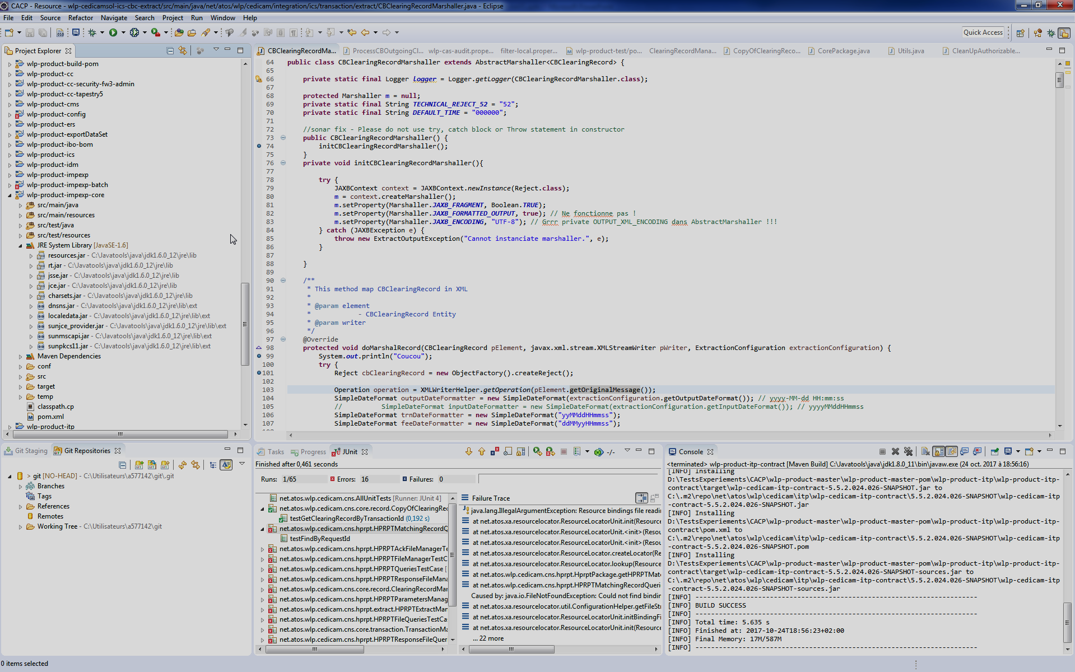
Notes:
After installation of the plugin:
Gather all the data in a DB +
Moose use to integrate the data inside the database and extract them for analysis

Slide 54
Test Recorder
Gathered Data:
Anonymized id
Project name
Repository URLs
Repository version
Test session start
Test session end
Tests executed
Fully qualified method name
Test duration
Test status
(pass, fail, error)
Notes:
More especially the gathered data are: …

Slide 55
Tests Session in our Case Study
Indivisible group of tests (class, package, project)
Execution of JUnit tests or Maven tests
Launched in one click
But, not representing the reality of the action
Limitations due to the IDEs
Notes:
A test session is an indivisible group of test that is launched in one click by Junit or Maven

Slide 56
Tests Session in our Case Study
Goal:
Link test sessions that test the same source code
Keep the intent of the developer
IDE Test sessions are not enough
Agglomerated test sessions

Slide 57
Tests Session in our Case Study
5 mn
5 mn
5 mn
5 mn
Time
C1
S1
S2
S3
S5
S6
C2
S7
t1
t2
t3
t4
t1
t5
t1
t2
t3
t4
t6
t7
A1
A2
A3
Notes:
T1 for example is one click -> 2 tests of the same class or package or project.
Tests before and after the commit are agglomerated -> no change in the source code
Transition: Now we gave the protocol of the case study, here are the results

Slide 58
Summary of the Case Study
 | Beller et al. (2015) | Gligoric et al. (2014) | Worldline
# Developers | 48 | 14 | 32
# Projects | 73 | 17 | 64
# Test sessions | 3 424 | 5 757 | 14 686
# Test executions | 10 840 | 264 562 | 153 763
Tests / Session | 3 | 46 | 11
Sessions / Developer | 71 | 411 | 459
Study Duration | 4 months | 3 months | 10 months
Notes:
First, a summary of the results
With 32 developers on 64 projects -> comparable to the others
10 months which is at least twice more in duration than the others ones.
Transition: now we will answer to the RQ presented before

Slide 59
Do Developers Test their Code Changes?
No correlation between:
Number of test runs vs Amount of code changes
More code changes do not lead to more tests
Same conclusion than Beller et al.
Frameworks are difficult to set up
Lack of time
Notes:
Ne pas dire les valeurs,
However, thanks to interviews,
Developers said that Frameworks are difficult to set up and they lack of time to test their changes

Slide 60
Do Quick Tests Lead to More Test Executions?
No correlation between:
Test execution length vs # of times test is executed
Tests launched are not selected according to their duration
Same conclusion than Beller et al.

Slide 61
Do Developers Practice Test Selection?
 |  | Min | Median | Max
% of executed tests in the project | Worldline | 0% | 4% | 100%
 | Beller | 0% | 1% | 100%
Test Selection occurs in 60% for Gligoric, 96% for Beller and 81% for Worldline
Notes:
For fifty percent of the test sessions less 4% of the test suite is executed.
Test selection is also made in 81 % of Worldline test sessions.
We can conclude that test selection is practiced at Worldline

Slide 62
Do Developers Practice Test Selection?
Heuristics to Select Tests from Interviews
Run all the tests of the subproject where the modifications have been made
Run tests based on naming conventions
Use the call graph available in the IDE to retrieve the tests to relaunch
Select tests according to their feelings and experience
Notes:
There are some profiles for testers:

Slide 63
Does Manual Test Selection Depend on Size of Code Changes?
No correlation between:
Number of tests selected in each test session
Size of code changes
Number of test selected is not influenced by the number of changes
More tests are run if several subprojects are impacted
Notes:
From the interviews: developers say they execute more tests if several subprojects are impacted

Slide 64
Automatic vs Manual Selection
Precision: 37% (Manually selected tests are correct)
Recall: 29% (Required tests are manually selected)
Manual test selection is not accurate (minimalist rather than safe)
Developers said that they do not carefully select tests
Select More: to test all the application
Select Less: to test only one algorithm
[Blondeau et al., ICSME’ 17] Rank A
Notes:
Comparison of automatic and manual selection
37% of manually selected tests are also selected by the automatic test selection (precision)
29% of the tests selected by the automatic selection are also selected manually (recall)

Slide 65
Test Selection Tool
Notes:
Now that we established current testing behavior of developers, we will describe the test selection tool we implemented

Slide 66
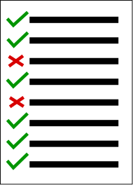
User Workflow
Client
Server
Test Selector
Models + Changes
Tests
Notes:
2 plugins for intelliJ
Changes = code changes
Best static strategy that resolve all the issues
Real time
The tests are selected thanks to a strategy configured by the user.

Slide 67
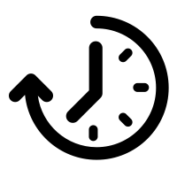
First Approach Workflow
+
+
$$∆$$
-
+
-
+
+
+
*
Client
Server
Client
Notes:
Naïve implementation
Model has twice the complete source code
Delta to compute on the whole model ->time
Bandwidth issues
Solution : Use partial models
Model only the files changed

Slide 68
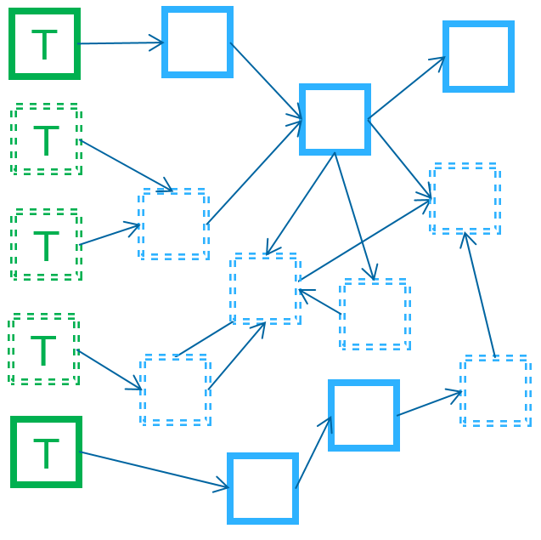
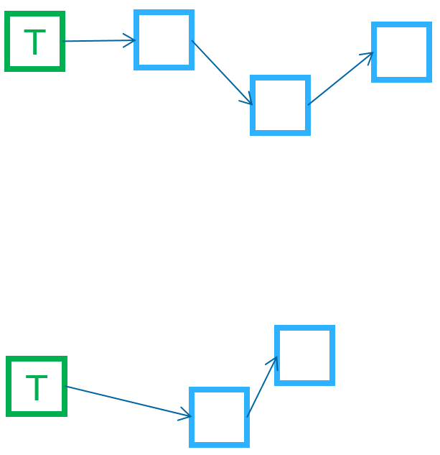
Improved Workflow
+
+
-
+
-
+
$$∆$$
+
+
Client
Server
Client
Notes:
S

Slide 69
Features
Test Selection triggered by:
Commit
Save
After few minutes
Execute the selected tests:
On demand
Automatically
Run tests through JUnit runner
Notes:
Strategies to select the tests
Strategies to execute the tests

Slide 70
Conclusion and Future Work
Notes:
And I will present the future works too

Slide 71
Conclusion
Test Selection at Worldline could work!
Notes:
Tool adapted to the Worldline developers:
issues resolved
adapted to their behavior
Transition: to summarize

Slide 72
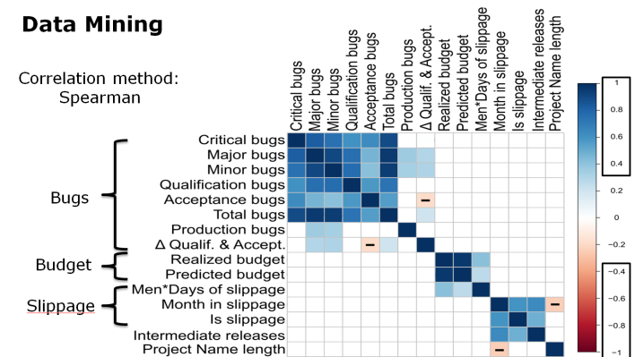
Conclusion
Notes:
First: Exploratory topic: Identifying root causes of project failures
Literature & data mining: we were not bale to predict failure in our context
Interviews: root causes of project failure:
Communication
Project Requirements
Questionnaire confirms the results
Identify a new topic: testing

Slide 73
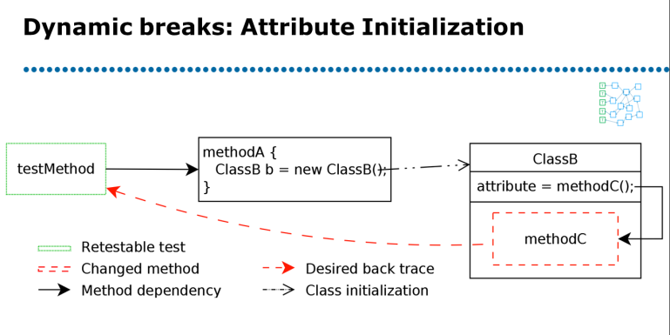
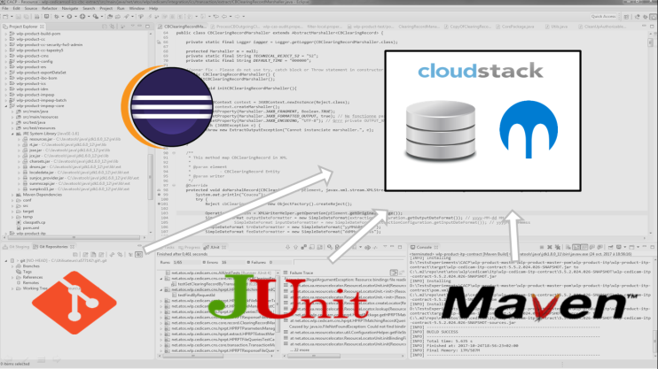
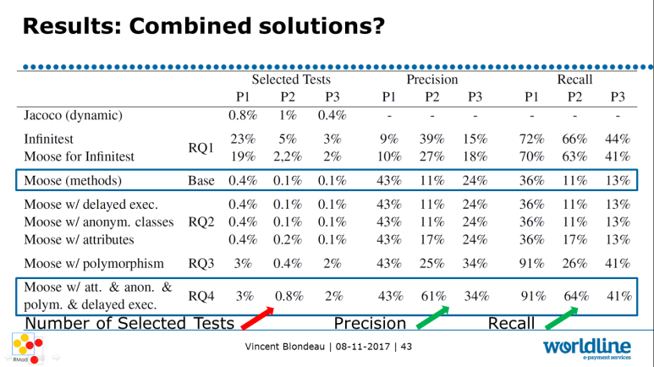
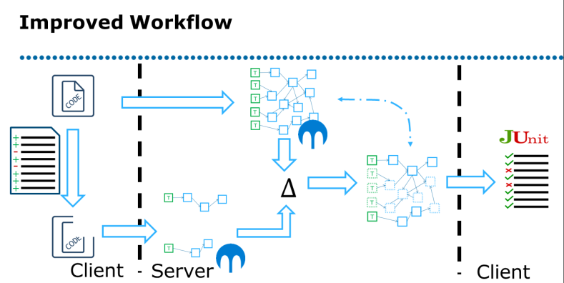
Conclusion
Notes:
Improving Testing Habits of Worldline developers
Identify and categorize issues for test selection
Impact of the issues on test selection
Study current testing behavior at Worldline
Manual test selection is not accurate (minimalist rather than safe)
Create a test selection tool adapted to Worldline

Slide 74
Production
Publications
4 workshops
ICSME – International Conference on Software Maintenance and Evolution
Software Quality Journal
Tools
4 Java plugins for Eclipse and IntelliJ
Test selection algorithms for Moose with infrastructure
Various projects: Orion, FamixDiff, R, Git log parser

Slide 75
Future Works: Industrial
Study subjectives metrics of the project health to make them more objective
Open sourcing the plugins and test selection infrastructure

Slide 76
Future Works: Academic
Measure the impact of the test selection tool:
Replication of the experiment in the Pharo context
Discover missing tests by comparing static and dynamic approaches
Coevolution between tests and application source code
Notes:
Measure of the impact of the tool: Not at Worldline, I am not in the company anymore.
But, in the Pharo community: someone is already working on it

Slide 77
Questions?
[Blondeau et al., SQJ’16]
[Blondeau et al., ICSME’17]

Slide 78
Thanks For more information please contact: vincent.blondeau@inria.fr

Slide 79
Possible tracks
Tests
Help test generation
Impact of source code change on tests
Quality
Measure source code quality
Categorize risks
Libraries and frameworks
Keep backward compatibility
Help software understanding

Slide 80
Experimental Constraints
Must not impact developer development process
Changes are available at commit level in the repository
Need to link the commit to the changes
Agglomeration of test sessions due to IDE capacities

Slide 81
Results
Weight by the number of commits
Not very different
Consider commit changes
Very small worsening of the results
More tests selected
Recall decreasing
Notes:
First Tests = individual methods
That is more realistic by considering multiples changes
The idea is that the most
committed Java methods could have consistently good (or bad) results

Slide 82
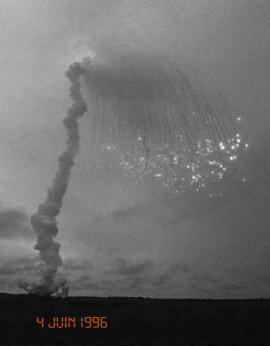
37 seconds later

Slide 83
Thanks For more information please contact: vincent.blondeau@worldline.com

